Slide 1
Climb Tracker
Week 8 Project
Thomas Ayling
22AprEnable1

Slide 2
MVP
My MVP is to create an API with fully functional CRUD methods on 3 tables;
Users
Routes
Climbs
And to then design a website that communicates with the API to let a user interact with the data and to log records of their climbs.
Version 1 will only have support for users to create, read and delete climbs and to create and log in to new user accounts

Slide 3
MoSCoW
Must have | Should have | Could have | Won’t have
A database with 3 tables. An API that has full CRUD functionality on all 3 tables. A website with two pages. A login page where users can login to existing accounts and sign up to a new account. A home page where users can create, read and delete their climbs. Full documentation to support the project. A jira board to manage the project and make sure time is managed effectively. | The ability to logout of accounts. Handling for user input errors. 80% or higher test coverage. Update functionality on climbs. Secure channels for user information. Cookies for storing user information when logged in. Protection against SQL and HTML injections. | An admin page for people that work at the climbing gym. A portal for admins to create, read, update and delete routes. A leaderboard for users to be able to compete with one another on routes. Another table for gyms if the product gets to a point that more than one gym uses the application. | The option for users to delete routes.

Slide 4
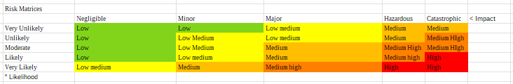
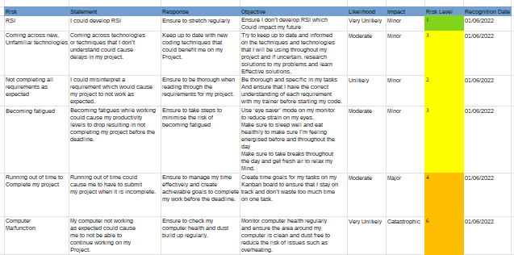
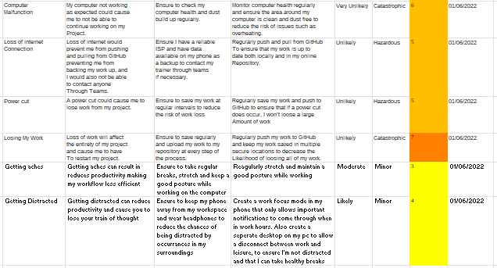
Risk Assessment
Unfortunately a fair few of my risks happened.
I came across a few unfamiliar methods and technologies during the project that slowed me down a bit, as well as a fair few unexpected errors
I also ended up without any connection to the internet for a good few hours mid-way through the project. Thankfully my risk assessment prepared me for these situations and the outcome of the risks wasn’t as detrimental as it could have been had I not been prepared.

Slide 5
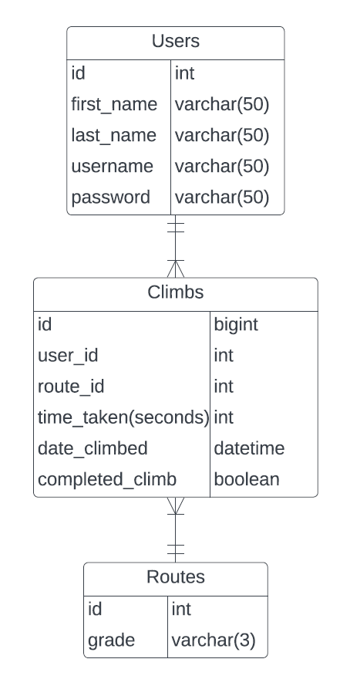
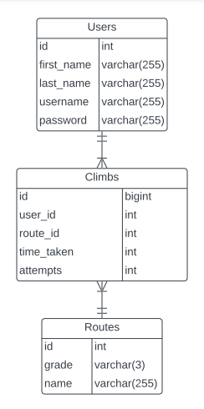
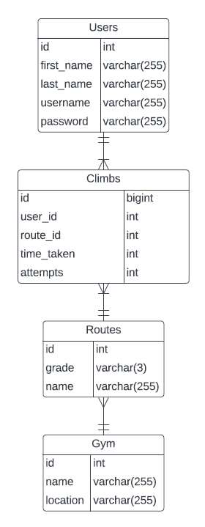
Entity Relationship Diagrams
VERSION 0.0.1
VERSION 1.0
VERSION 3.0

Slide 6
Sprints
My first sprint included coding the API, creating CRUD methods for each of my tables
My second sprint was for coding the front-end of the project using javascript and HTML which needed longer to complete than the first sprint
The last sprint of version 1 included testing and ensuring the software was bug-free and ready for deployment
I had another sprint for a theoretical version 2, and another for version 3

Slide 7
GitHub
My main branch stayed isolated throughout the project.
I forgot to push my dev branch before creating my feature 1 branch so the network graph isn’t quite how I expected it to be
I created feature branches for each of my jira sprints, and each task then had its own branch coming off the feature branches

Slide 8
Skills
For this project, I needed time management skills along with the ability to troubleshoot confusing errors.
My spring knowledge saved me a lot of time and my use of Lombok made the code very concise.
My limited javascript knowledge paired with googling skills meant that my website worked just how I wanted it too, although tweaks will definitely be made to styles in upcoming versions.

Slide 9
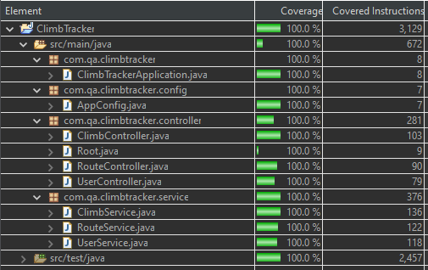
Test Coverage
I reached 100% coverage in my unit testing
Without any coverage tracking on selenium, I would say that I did reach 80% coverage if not more

Slide 10
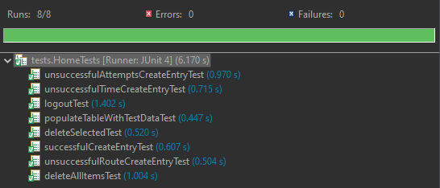
Selenium testing
In selenium, I tested the main functionalities of my front-end, including purposefully entering invalid information in to my forms to ensure the issues were handled correctly on the front end.

Slide 11
Live Demo

Slide 12
Thanks for listening!

